Slide 1
An Explainable AI Framework for Chromosomal Anomaly Detection in Karyograms Using Grad-CAM and Advanced Neural Networks
Sumaira Tabassum, M. Jawad Khan, Javaid Iqbal, Asim Waris, M. Adeel Ijaz
ICCIS2024

Slide 2
Contents
Introduction
Problem statement
Background
Our Approach
Dataset Overview
Methodology
Results
Conclusion

Slide 3
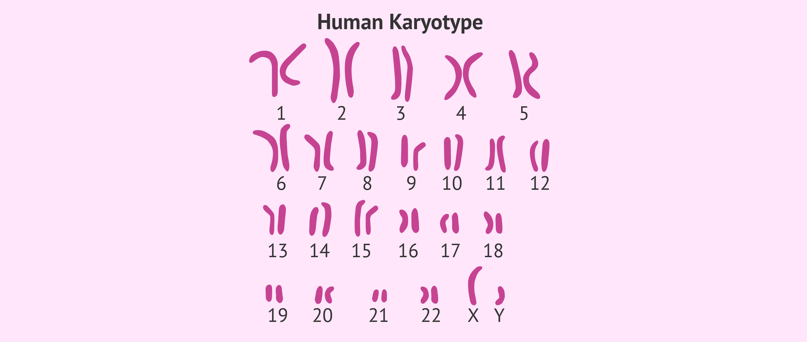
Introduction
Karyotyping is a test to examine chromosomes in a sample of cells.
It is a technique used to analyze chromosomes and detect genetic disorders, providing critical insights into human health.
It is essential for diagnosing conditions such as Down and Turner syndrome and cancer.

Slide 4
Introduction
The traditional process of identifying chromosomal abnormalities is labor-intensive and requires significant expertise.
These challenges make karyotyping an ideal candidate for automation using AI methods like deep learning.
Automated systems can minimize human error, accelerate analysis, and deliver consistent results even across large datasets.

Slide 5
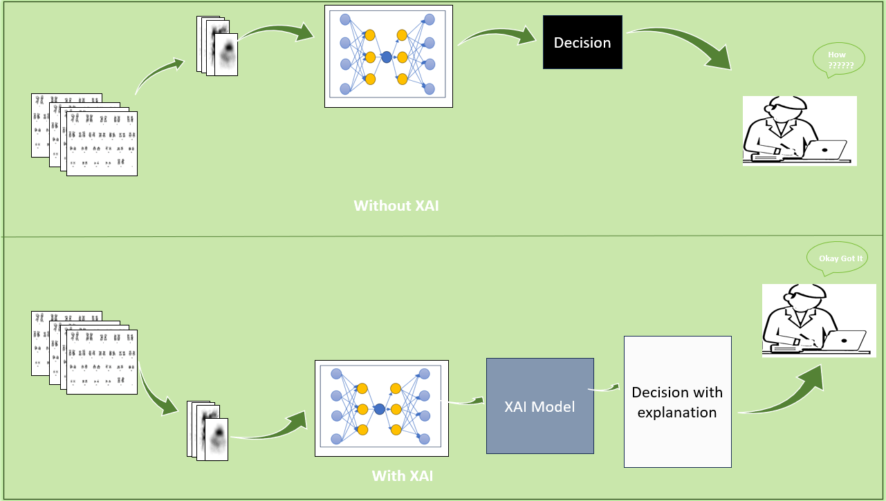
Introduction
BUT
The "black box" nature of deep learning models creates a barrier to trust, particularly in critical medical applications where clinicians must understand and rely on AI predictions.
SO
Explainable AI (XAI) methods are the solution. XAI is essential for enhancing transparency and interpretability, helping users understand how models arrive at their predictions.

Slide 6
Our Approach
We propose a novel deep learning-based approach for detecting chromosomal anomalies in karyograms, specifically focusing on the del(q20) anomaly in chromosome 20.
Our method incorporates Grad-CAM, an explainable AI technique, to detect ROI and to enhance the interpretability of the model by visualizing important regions of the karyogram that influence prediction outcomes.
We present a new dataset of 7680 karyograms, to the best of our knowledge, the first of its kind, and demonstrate its application in training and evaluating the model.
Our approach achieves high test classification accuracy (98%) in detecting the del(q20) chromosomal aberration, offering a reliable and explainable solution for genetic disorder diagnosis.

Slide 7
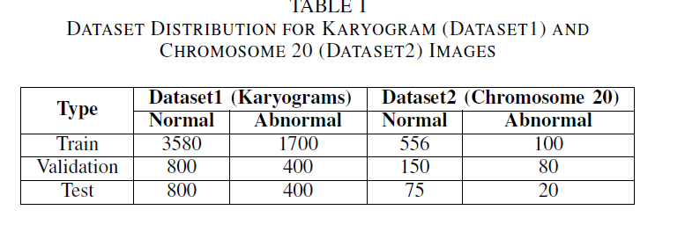
Dataset Overview
Custom Dataset for Karyogram Analysis
→Built specifically for karyogram classification and chromosomal anomaly detection.
→The unique inclusion of numerical and structural abnormalities, including the rare del(20q).

Slide 8
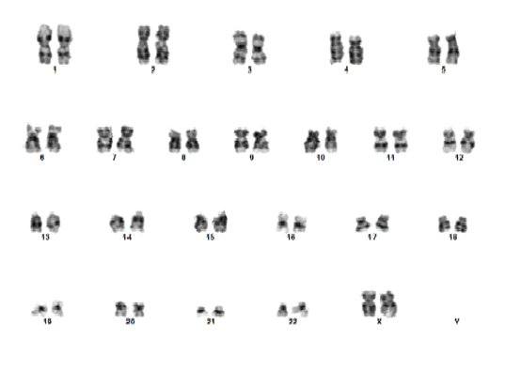
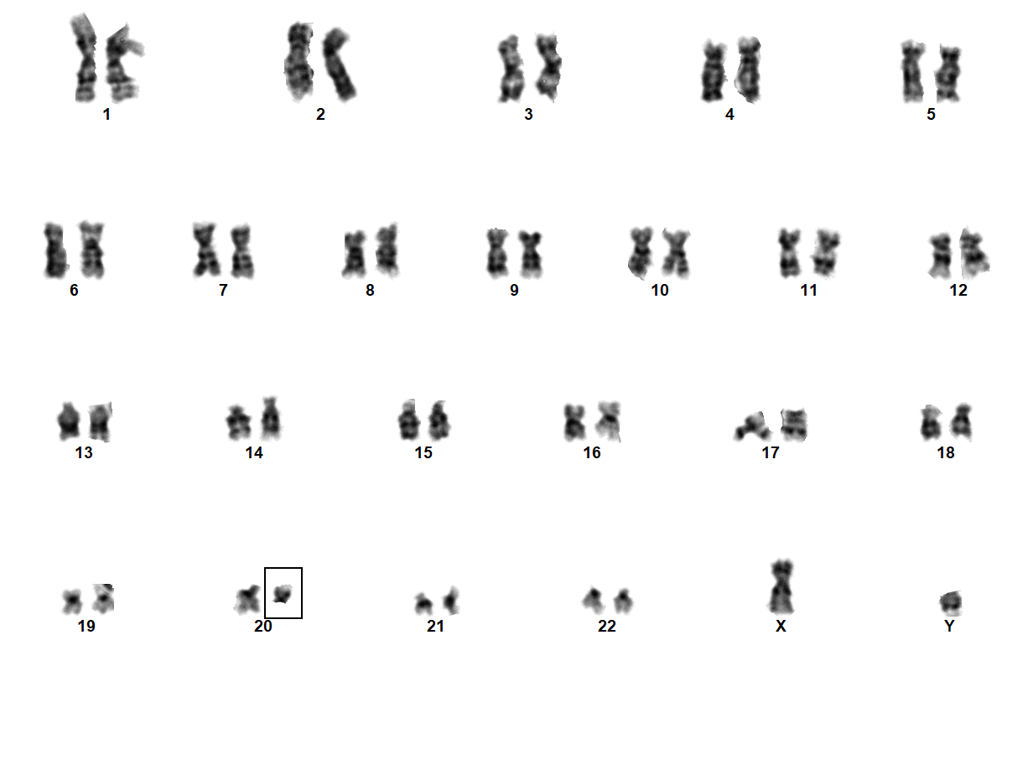
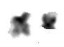
Significance Of Dataset
→No publicly available dataset includes both numerical and structural chromosomal abnormalities.
→Designed to facilitate Explainable AI (XAI) research in karyogram analysis.
Normal Karyogram
Single chromosomes
Abormal Karyogram

Slide 9
Methodology
Our methodology is divided into three key steps to ensure a comprehensive approach for karyogram classification and anomaly detection
1: Karyogram analysis
3: ROI extraction
4: Anomaly del(q20) detection with explanation

Slide 10
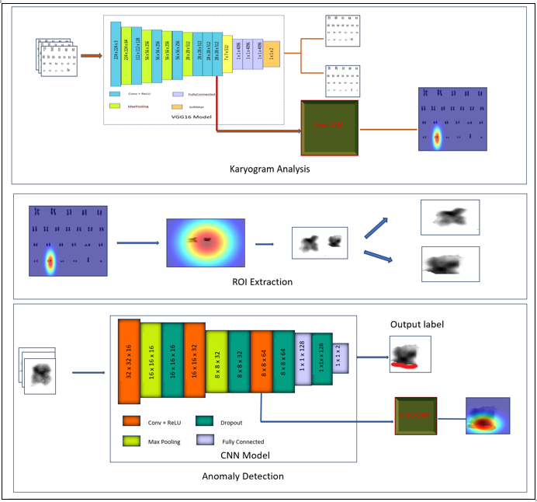
Methodology

Slide 11
Karyogram analysis
The pre-trained VGG16 model is applied to classify karyogram images, determining whether they are normal or abnormal based on chromosomal structures.
Grad-CAM is employed to highlight the Regions of Interest (ROIs) in abnormal karyograms, focusing on specific chromosomes, such as chromosome 20, where anomalies are typically observed.
The regions identified by Grad-CAM are compared with the ground truth annotations provided by experts to ensure the validity of the identified anomalies and confirm the accuracy of the regions highlighted.

Slide 12
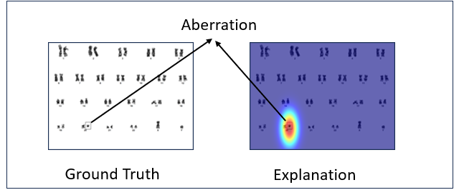
ROI Extraction and Cropping
After the ground truth verification, the abnormal regions are cropped from the original karyogram image for detailed analysis.

Slide 13
Anomaly Detection
We are detecting anomalies in singlets chromosome images with custom CNN model. This involves several steps
→Chromosome 20 Classification with Custom CNN
→After the ROI is extracted, it is passed through a custom CNN model to classify the region as either normal or abnormal, focusing specifically on detecting abnormalities in chromosome 20.

Slide 14
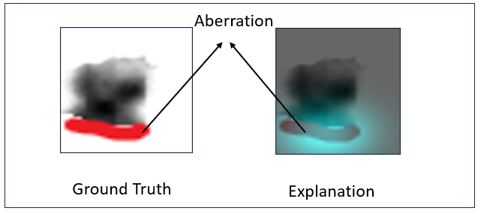
Anomaly Detection
→Once the cropped chromosome 20 region is classified, Grad-CAM is applied to generate a heatmap that visually explains the model’s decision-making process, highlighting the most critical features influencing the classification.
→The identified regions and classifications are then validated by comparing them to expert annotations from cytogeneticists, ensuring that the results are accurate and reliable.

Slide 15
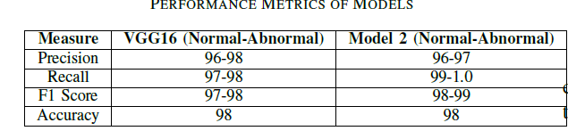
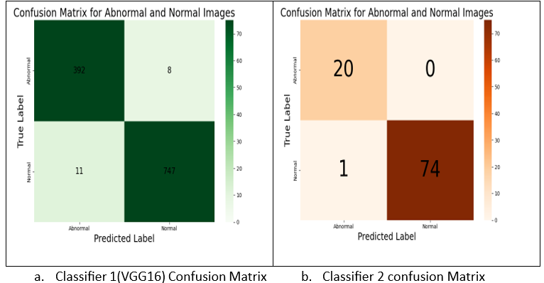
Results

Slide 16
Conclusion
In conclusion, we propose a novel deep learning approach for karyogram classification and anomaly detection, specifically targeting del(20q). Unlike prior methods focused on chromosome classification without interpretability, our approach uses a custom dataset of 7,680 karyogram images, covering both numerical and structural abnormalities. By incorporating Explainable AI (XAI) through Grad-CAM, we enhance transparency and trust, achieving 98% accuracy with a fine-tuned VGG16 model.
Grad-CAM visual explanations, validated by expert annotations, confirm the accuracy of highlighted regions. Additionally, a custom CNN for del(20q) detection also achieved 98% accuracy. The alignment between Grad-CAM results and expert annotations demonstrates the model's reliability. This automated pipeline offers a robust tool for early detection of genetic disorders, aiding cytogeneticists in timely diagnoses and interventions.

Slide 17
References
K. Yi and Y. S. Ju, “Patterns and mechanisms of structural variations in human cancer,” Experimental & Molecular Medicine, vol. 50, no. 8, 2018, pp. 1–11.
D. W. Bianchi and L. Wilkins-Haug, “Integration of noninvasive DNA testing for aneuploidy into prenatal care: what has happened since the rubber met the road?,” Clinical Chemistry, vol. 60, no. 1, 2014, pp. 78–87.
M. T. Ribeiro, S. Singh, and C. Guestrin, “Why should I trust you? Explaining the predictions of any classifier,” in Proceedings of the 22nd ACM SIGKDD International Conference on Knowledge Discovery and Data Mining, Aug. 2016, pp. 1135–1144.
B. H. Van der Velden, H. J. Kuijf, K. G. Gilhuijs, and M. A. Viergever,‘Explainable artificial intelligence (XAI) in deep learning-based medical image analysis,” Medical Image Analysis, vol. 79, 2022, Art. no. 102470.
Z. C. Lipton, “The mythos of model interpretability: In machine learning, the concept of interpretability is both important and slippery,” Queue, vol. 16, no. 3, pp. 31–57, 2018.
M. T. Ribeiro, S. Singh, and C. Guestrin, “Why should I trust you? Explaining the predictions of any classifier,” in Proceedings of the 22nd ACM SIGKDD International Conference on Knowledge Discovery and Data Mining, Aug. 2016, pp. 1135–1144.

Slide 18
Thank You

